Slide 1
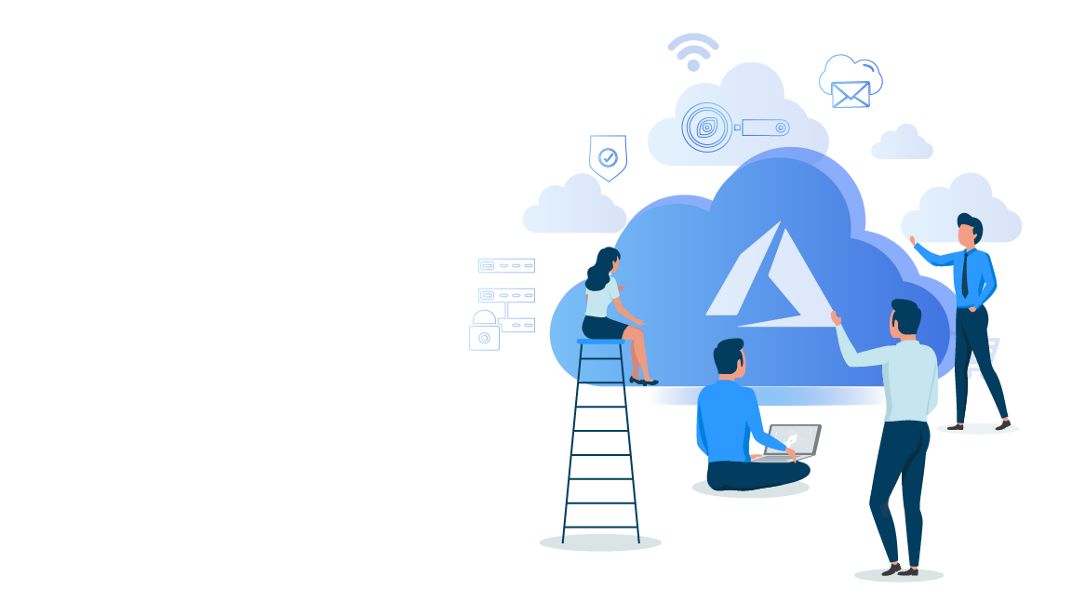


Microsoft Azure Administrator Associate Training(AZ-103)
Module 1

Slide 2
Agenda
Introduction To Cloud Computing
01
02
What Is Microsoft Azure?
Microsoft Azure Services
03
04
Creating An Account In Azure
Different Ways Of Accessing Microsoft Azure
05
06
Azure Resources And Subscriptions
Understanding Azure Resource Manager
07
08
Demo: Managing Azure Resources
Quiz
09

Slide 3
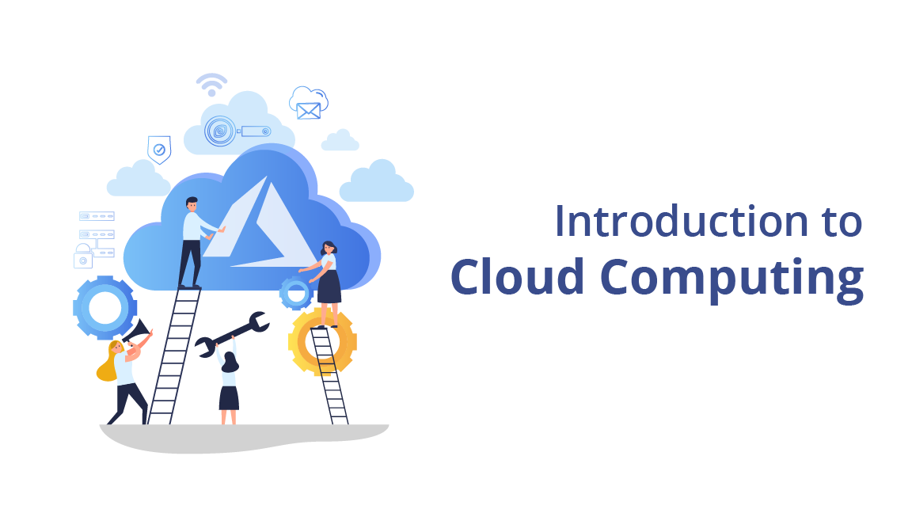

Slide 4
Why Cloud Computing?

Slide 5









Before Cloud Computing
Invests some money
Buys some servers
Launches application

Slide 6




Before Cloud Computing
Buys some more servers
Back to use

Slide 7

Before Cloud Computing
Maintenance team
Fixes the servers

Slide 8
Before Cloud Computing
What to do?

Slide 9


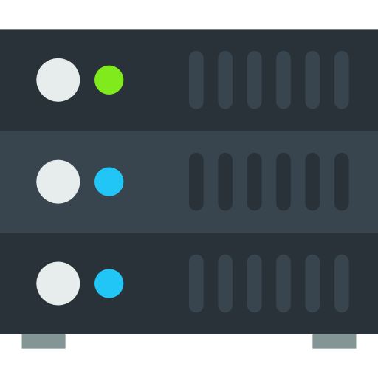


Before Cloud Computing
Scalability
Increase hardware as user demand increases. Increase staff to maintain the servers.
High Cost
High upfront expenses and capital expenditure.
High maintenance costs.
Server
Servers need to be managed and monitored continuously
Slow Data Recovery
Takes more time to recover the data. Requires high budgets and resources.

Slide 10



After Cloud Computing
Scalability
Can easily scale up and down to meet demand.
Cost
Users pay only for the resources they use.
Server
All the resources and servers are maintained by vendors.
Data Recovery
Fastest data recovery as cloud creates backup.

Slide 11
What is Cloud Computing?

Slide 12
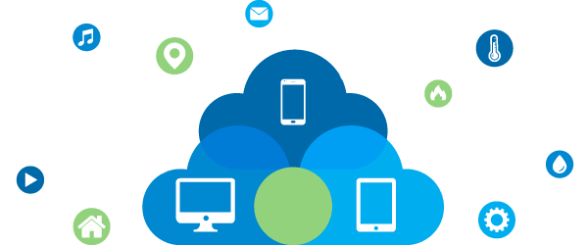
What is Cloud Computing?
Cloud computing is the delivery of computing services like servers, storage, databases, networking, software, analytics, intelligence and more—over the Internet to offer faster innovation, flexible resources and economies of scale.

Slide 13

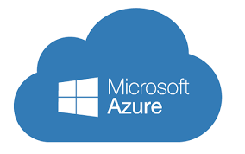


What is Cloud Computing?
Cloud computing is basically accessing and using various computing services and resources via the internet
Cloud Computing
User
Virtual machines, storage, etc.

Slide 14
Types of Cloud Computing

Slide 15


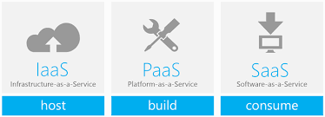




Types of Cloud Computing
Service Models
Deployment Models
Public cloud
Private cloud
Hybrid cloud
IaaS
PaaS
SaaS

Slide 16
Types of Cloud Computing - Service Models

Slide 17
Service Models
Infrastructure as a Service means delivering the whole infrastructure of a general computer as a service. In IaaS, you get complete access to server's OS, processing power and more.
Infrastructure as a Service
Platform as a Service
Software as a Service

Slide 18
Service Models
As opposed to IaaS, in PaaS you do not get access to the whole OS. You are given the access to an already set up environment where you can run or develop applications.
Infrastructure as a Service
Platform as a Service
Software as a Service

Slide 19
Service Models
SaaS means delivering a whole software to the customer as a service, so the customer can directly access and use the software without installing anything or updating anything.
Infrastructure as a Service
Platform as a Service
Software as a Service

Slide 20
Types of Cloud Computing - Deployment Models

Slide 21
Deployment Models
Public cloud refers to the standard cloud computing, which means that the cloud provider offers resources such as virtual machines, storage, applications, to the general public over the internet.
Public Cloud
Private Cloud
Hybrid Cloud
Public cloud

Slide 22
Deployment Models
Private cloud is a pool of resources meant exclusively for a single organization.
Public Cloud
Private Cloud
Hybrid Cloud
Private cloud

Slide 23


Deployment Models
Accessible to anyone. Meant for general public.
Owned by a single person. Not meant for general public.
Bus
Car

Slide 24
Deployment Models
Public cloud
Private cloud
Bus
Car

Slide 25
Deployment Models
Hybrid cloud refers to a cloud computing environment that uses the combination of both, private as well as public cloud.
Public Cloud
Private Cloud
Hybrid Cloud
Hybrid cloud

Slide 26
What is Microsoft Azure?

Slide 27

What Is Microsoft Azure?
Microsoft Azure is a cloud computing platform offered by Microsoft. Microsoft azure offers various web scale cloud services.

Slide 28
What Is Microsoft Azure?
Microsoft Azure is a cloud computing platform offered by Microsoft. Microsoft azure offers various web scale cloud services.

Slide 29






What Is Microsoft Azure?
Establishment
Cost Effective
Availability Zones
launched on February 1st, 2010
Free to get started. Offers pay per use pricing model.
Datacenters in 54 regions around the world
Widely Recognized
Language Support
Supports multiple languages such as C#, Node.Js, Java and more.
Used by more than 90 % of Fortune 500 companies

Slide 30
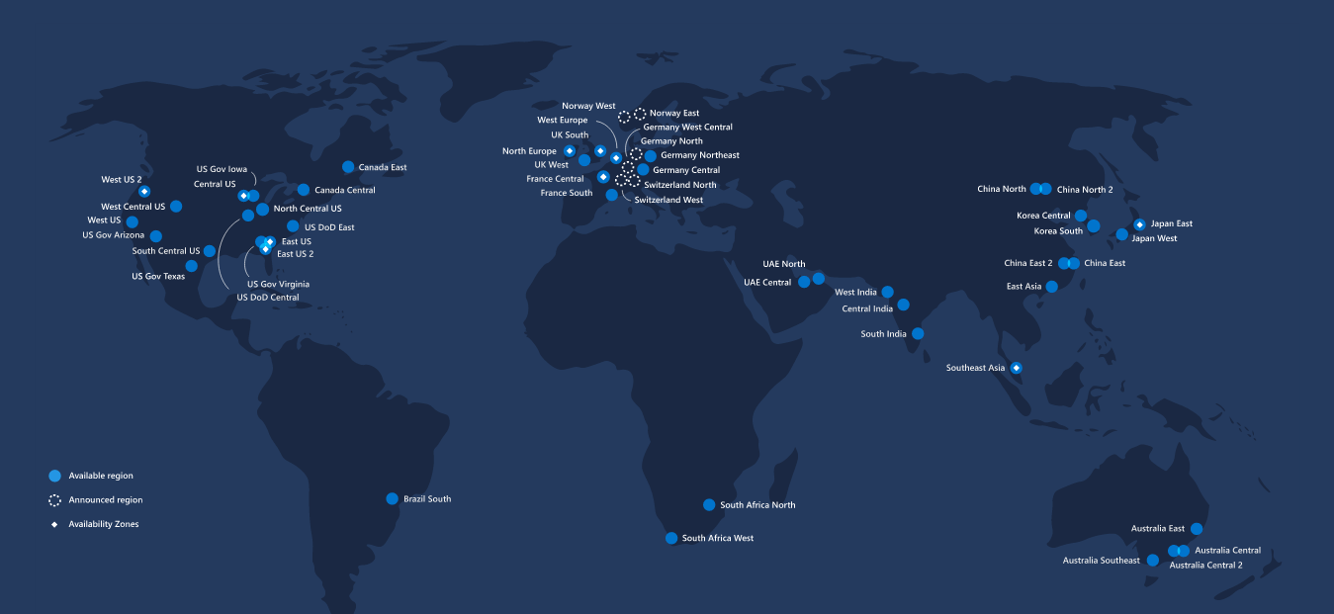
Azure Regions & Availability Zones
Azure has more global regions than any other cloud provider. In total, there are 54 regions worldwide and Azure is available in 140 countries.

Slide 31
Microsoft Azure Services

Slide 32



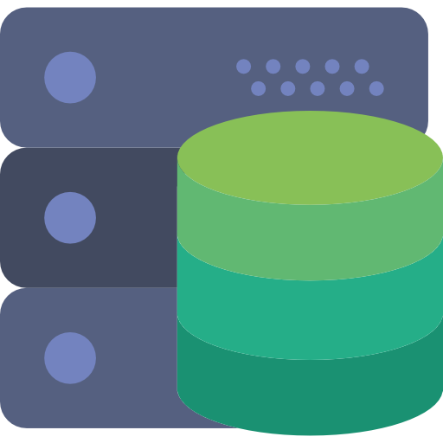
Microsoft Azure Services
Microsoft azure offers various web scale cloud services which are grouped together on the basis of different business usage. These groups are called domains. Some of the main domains are listed below.
Networking
Storage
Database
Compute

Slide 33
Microsoft Azure Services
Microsoft azure offers various web scale cloud services which are grouped together on the basis of different business usage. These groups are called domains. Some of the main domains are listed below.
Networking
Storage
Database
Compute

Slide 34
Microsoft Azure Services
Microsoft azure offers various web scale cloud services which are grouped together on the basis of different business usage. These groups are called domains. Some of the main domains are listed below.
Networking
Storage
Database
Compute

Slide 35
Microsoft Azure Services
Microsoft azure offers various web scale cloud services which are grouped together on the basis of different business usage. These groups are called domains. Some of the main domains are listed below.
Networking
Storage
Database
Compute

Slide 36
Microsoft Azure Services
Microsoft azure offers various web scale cloud services which are grouped together on the basis of different business usage. These groups are called domains. Some of the main domains are listed below.
Networking
Storage
Database
Compute

Slide 37
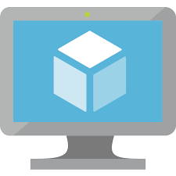


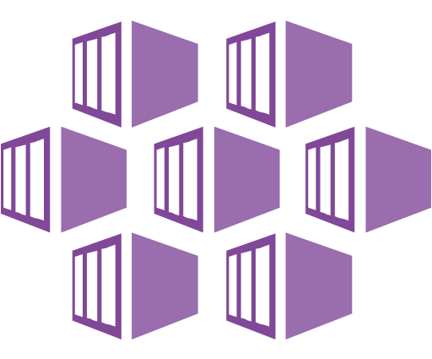
Azure Services – Compute
Function App
App Service
Azure Kubernetes Service
Virtual Machine

Slide 38
Microsoft Azure Services - Compute
Virtual Machines are IaaS offerings from Azure. It allows users to launch Windows and Linux virtual machines of their own choice configuration.
Virtual Machine
App Service is a Platform as a Service offering by Azure. This service provides already set up environments for developers for hosting and managing their applications
App Service
This service lets users run code or functions in cloud without having to manage underlying resource services.
Function App
This is a managed container orchestration service based on Kubernetes system. This service is used for micro service - based architecture applications.
Azure Kubernetes Service

Slide 39
Microsoft Azure Services - Compute
Virtual Machines are IaaS offerings from Azure. It allows users to launch Windows and Linux virtual machines of their own choice configuration.
Virtual Machine
App Service is a Platform as a Service offering by Azure. This service provides already set up environments for developers for hosting and managing their applications
App Service
This service lets users run code or functions in cloud without having to manage underlying resource services.
Function App
This is a managed container orchestration service based on Kubernetes system. This service is used for micro service - based architecture applications.
Azure Kubernetes Service

Slide 40
Microsoft Azure Services - Compute
Virtual Machines are IaaS offerings from Azure. It allows users to launch Windows and Linux virtual machines of their own choice configuration.
Virtual Machine
App Service is a Platform as a Service offering by Azure. This service provides already set up environments for developers for hosting and managing their applications
App Service
This service lets users run code or functions in cloud without having to manage underlying resource services.
Function App
This is a managed container orchestration service based on Kubernetes system. This service is used for micro service - based architecture applications.
Azure Kubernetes Service

Slide 41
Microsoft Azure Services - Compute
Virtual Machines are IaaS offerings from Azure. It allows users to launch Windows and Linux virtual machines of their own choice configuration.
Virtual Machine
App Service is a Platform as a Service offering by Azure. This service provides already set up environments for developers for hosting and managing their applications
App Service
This service lets users run code or functions in cloud without having to manage underlying resource services.
Function App
This is a managed container orchestration service based on Kubernetes system. This service is used for micro service - based architecture applications.
Azure Kubernetes Service

Slide 42




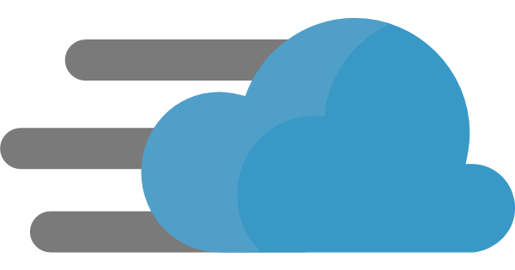
Azure Services – Networking
Virtual Networks
Load Balancers
Application Gateway
DNS Zones
CDN Profiles

Slide 43
Microsoft Azure Services -Networking
Virtual network or Vnet is a logically isolated network in the whole Azure cloud dedicated to your subscription.
Virtual Networks
This service is used to distribute the incoming traffic among multiple healthy virtual machines.
Load Balancers
Application gateway is a web traffic load balancer that lets user manage the traffic to their web applications.
Application Gateway
This is a hosting service for domains in Azure. you can manage your DNS records by hosting your domain in Azure.
DNS Zones
Azure content delivery network is a CDN solution by Azure. It is used to store cached version of applications or storage in different regions.
CDN Profiles

Slide 44
Microsoft Azure Services -Networking
Virtual network or Vnet is a logically isolated network in the whole Azure cloud dedicated to your subscription.
Virtual Networks
This service is used to distribute the incoming traffic among multiple healthy virtual machines.
Load Balancers
Application gateway is a web traffic load balancer that lets user manage the traffic to their web applications.
Application Gateway
This is a hosting service for domains in Azure. you can manage your DNS records by hosting your domain in Azure.
DNS Zones
Azure content delivery network is a CDN solution by Azure. It is used to store cached version of applications or storage in different regions.
CDN Profiles

Slide 45
Microsoft Azure Services -Networking
Virtual network or Vnet is a logically isolated network in the whole Azure cloud dedicated to your subscription.
Virtual Networks
This service is used to distribute the incoming traffic among multiple healthy virtual machines.
Load Balancers
Application gateway is a web traffic load balancer that lets user manage the traffic to their web applications.
Application Gateway
This is a hosting service for domains in Azure. you can manage your DNS records by hosting your domain in Azure.
DNS Zones
Azure content delivery network is a CDN solution by Azure. It is used to store cached version of applications or storage in different regions.
CDN Profiles

Slide 46
Microsoft Azure Services -Networking
Virtual network or Vnet is a logically isolated network in the whole Azure cloud dedicated to your subscription.
Virtual Networks
This service is used to distribute the incoming traffic among multiple healthy virtual machines.
Load Balancers
Application gateway is a web traffic load balancer that lets user manage the traffic to their web applications.
Application Gateway
This is a hosting service for domains in Azure. you can manage your DNS records by hosting your domain in Azure.
DNS Zones
Azure content delivery network is a CDN solution by Azure. It is used to store cached version of applications or storage in different regions.
CDN Profiles

Slide 47
Microsoft Azure Services -Networking
Virtual network or Vnet is a logically isolated network in the whole Azure cloud dedicated to your subscription.
Virtual Networks
This service is used to distribute the incoming traffic among multiple healthy virtual machines.
Load Balancers
Application gateway is a web traffic load balancer that lets user manage the traffic to their web applications.
Application Gateway
This is a hosting service for domains in Azure. you can manage your DNS records by hosting your domain in Azure.
DNS Zones
Azure content delivery network is a CDN solution by Azure. It is used to store cached version of applications or storage in different regions.
CDN Profiles

Slide 48
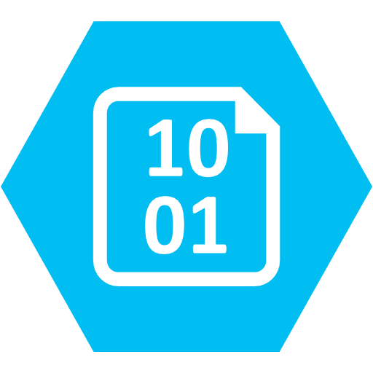

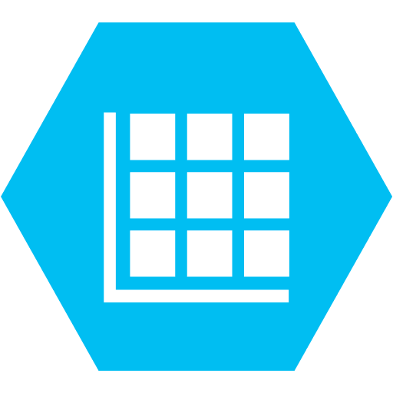



Azure Services – Storage
Blob
File Storage
Tables
Queues
Data Lake Storage
Data Box

Slide 49
Microsoft Azure Services - Storage
Azure blob is an object type storage in Azure. It is used for storing large amounts of unstructured data.
Blob
This is a file storage solution by Azure. It supports the SMB (Server Message Block) protocol.
File Storage
Azure tables are used to store large amount of structured data. It is a NoSQL database so it can store non - relational data.
Tables

Slide 50
Microsoft Azure Services - Storage
Azure blog is an object type storage in Azure. It is used for storing large amounts of structured or unstructured data.
Blob
This is a file storage solution by Azure. It supports the SMB (Server Message Block) protocol.
File Storage
Azure tables are used to store large amount of structured data. It is a NoSQL database so it can store non - relational data.
Tables

Slide 51
Microsoft Azure Services - Storage
Azure blog is an object type storage in Azure. It is used for storing large amounts of structured or unstructured data.
Blob
This is a file storage solution by Azure. It supports the SMB (Server Message Block) protocol.
File Storage
Azure tables are used to store large amount of structured data. It is a NoSQL database so it can store non - relational data.
Tables

Slide 52
Microsoft Azure Services - Storage
This service is used for storing large number of messages that can be accessed from anywhere in the world using authenticated HTTP or HTTPS calls.
Queues
Azure Data Lake Storage is an enterprise-wide hyper-scale repository for big data analytics workloads. Azure Data Lake enables you to capture data of any size, type, and ingestion speed in one single place for operational and exploratory analytics.
Data Lake Storage
This service can be used to move data to Azure quickly. Data Box offline devices easily move data to Azure when busy networks are not an option. Data Box online appliances transfer data to and from Azure over the network.
Data Box

Slide 53
Microsoft Azure Services - Storage
This service is used for storing large number of messages that can be accessed from anywhere in the world using authenticated HTTP or HTTPS calls.
Queues
Azure Data Lake Storage is an enterprise-wide hyper-scale repository for big data analytics workloads. Azure Data Lake enables you to capture data of any size, type, and ingestion speed in one single place for operational and exploratory analytics.
Data Lake Storage
This service can be used to move data to Azure quickly. Data Box offline devices easily move data to Azure when busy networks are not an option. Data Box online appliances transfer data to and from Azure over the network.
Data Box

Slide 54
Microsoft Azure Services - Storage
This service is used for storing large number of messages that can be accessed from anywhere in the world using authenticated HTTP or HTTPS calls.
Queues
Azure Data Lake Storage is an enterprise-wide hyper-scale repository for big data analytics workloads. Azure Data Lake enables you to capture data of any size, type, and ingestion speed in one single place for operational and exploratory analytics.
Data Lake Storage
This service can be used to move data to Azure quickly. Data Box offline devices easily move data to Azure when busy networks are not an option. Data Box online appliances transfer data to and from Azure over the network.
Data Box

Slide 55
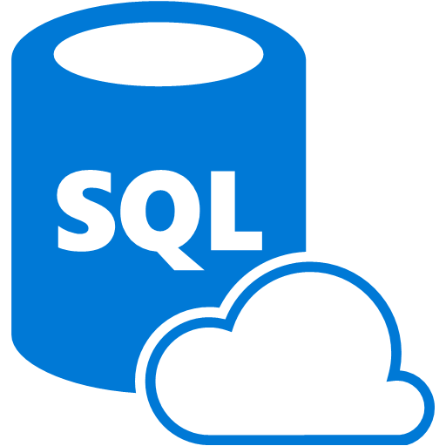



Azure Services – Database
SQL Database
CosmosDB
Data Factory
Data Lake Analytics

Slide 56
Microsoft Azure Services -Database
It's basically a SQL server but on cloud. It works to create, scale and extend applications into the cloud using MS SQL Server technology.
SQL Database
Cosmos DB is a NoSQL database service that implements a subset of the SQL SELECT statement on JSON documents.
CosmosDB
This service is a fully managed service for composing data storage, processing, and movement services into streamlined, scalable, and reliable data production pipelines.
Data Factory
Azure Data Lake is a scalable data storage and analytic service for big data analytics workloads that require developers to run massively parallel queries.
Data Lake Analytics

Slide 57
Microsoft Azure Services -Database
It's basically a SQL server but on cloud. It works to create, scale and extend applications into the cloud using MS SQL Server technology.
SQL Database
Cosmos DB is a NoSQL database service that implements a subset of the SQL SELECT statement on JSON documents.
CosmosDB
This service is a fully managed service for composing data storage, processing, and movement services into streamlined, scalable, and reliable data production pipelines.
Data Factory
Azure Data Lake is a scalable data storage and analytic service for big data analytics workloads that require developers to run massively parallel queries.
Data Lake Analytics

Slide 58
Microsoft Azure Services -Database
It's basically a SQL server but on cloud. It works to create, scale and extend applications into the cloud using MS SQL Server technology.
SQL Database
Cosmos DB is a NoSQL database service that implements a subset of the SQL SELECT statement on JSON documents.
CosmosDB
This service is a fully managed service for composing data storage, processing, and movement services into streamlined, scalable, and reliable data production pipelines.
Data Factory
Azure Data Lake is a scalable data storage and analytic service for big data analytics workloads that require developers to run massively parallel queries.
Data Lake Analytics

Slide 59
Microsoft Azure Services -Database
It's basically a SQL server but on cloud. It works to create, scale and extend applications into the cloud using MS SQL Server technology.
SQL Database
Cosmos DB is a NoSQL database service that implements a subset of the SQL SELECT statement on JSON documents.
CosmosDB
This service is a fully managed service for composing data storage, processing, and movement services into streamlined, scalable, and reliable data production pipelines.
Data Factory
Azure Data Lake is a scalable data storage and analytic service for big data analytics workloads that require developers to run massively parallel queries.
Data Lake Analytics

Slide 60
Creating a Microsoft Azure Account

Slide 61
Creating A Microsoft Azure Account
Enter the email address and password
You will receive a code in email.
Agree to the terms and conditions then click "Sign up“
You're now signed up and ready to go.
Step 1
Go to the home page of Azure
Step 4
Step 5
Step 8
Step 9
you wish to associate with your new Azure account.
Check your inbox and then enter here to verify
And click on start free to create new account.
Click the green button on the blue banner labelled "Start for free“
Click "Create Microsoft account“ to create a new account.
Enter a phone number for your account.
Click the green button to start using Microsoft Azure
Step 2
Step 3
Step 6
Step 7
Fill in the details in given form
Step 10
You will receive a code by text that you should enter to verify.
Enter valid card details. You won’t be charged in free period

Slide 62
Different ways of accessing Microsoft Azure - Portal, PowerShell and CLI

Slide 63
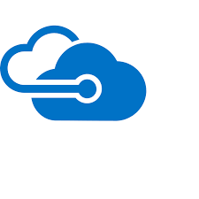


Ways of accessing Microsoft Azure
Microsoft provides various ways to access Microsoft Azure platform. For those who prefer GUI, there is Azure Classic Portal. For those who prefer command line tools can use Azure PowerShell or Azure CLI.
Azure Portal
Azure CLI
Windows PowerShell

Slide 64
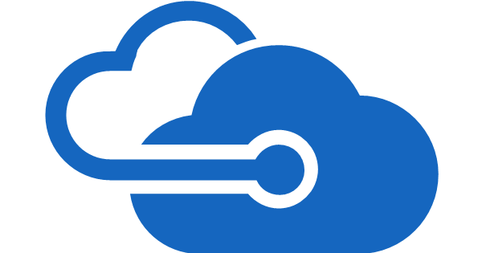
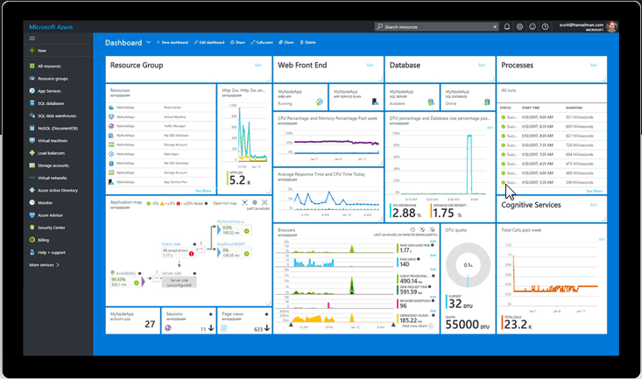
Azure Portals
Azure Portal is a web based, unified console that lets users access and manage Azure services. Using Azure Portal, users can build, monitor and manage their applications on Azure Cloud. To sign into the portal, users need to have an Azure account.
Azure Portal

Slide 65
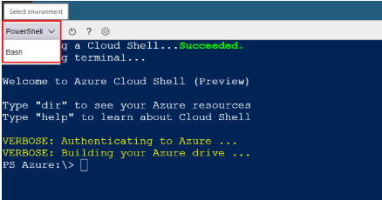
Azure PowerShell
Azure PowerShell is a task based command line shell. It is built on .NET Framework and lets users control Azure's robust functionality, from a command line.
Azure PowerShell

Slide 66
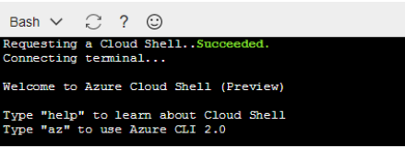
Azure CLI
Azure CLI is a cross -platform command line tool, that is used to manage and monitor Microsoft Azure platform and services. It provides an alternative for PowerShell.
Azure CLI

Slide 67
Azure Resources and Subscriptions

Slide 68

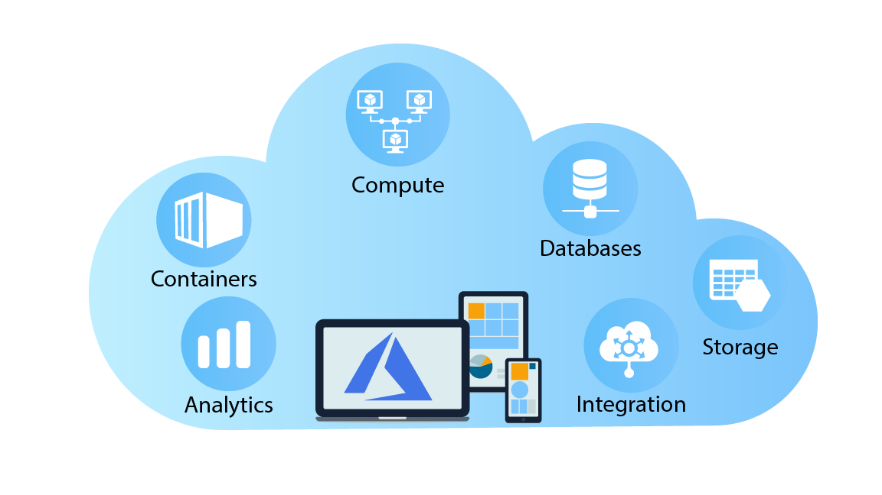
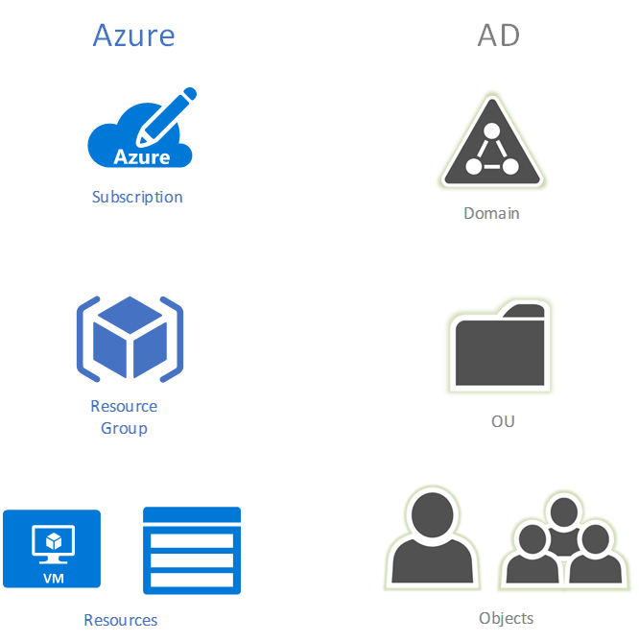
Azure Subscriptions
Azure subscription is an active agreement between the users and Microsoft. This agreement provides users the needed access to provision services and resources offered by Microsoft Azure.
End Users

Slide 69
Azure Subscriptions
Azure Subscriptions are associated with Azure Accounts. Azure accounts are where the user can track the usage and billing of their Azure services. Azure accounts are also used to access the tools that are used to access Azure services.
Azure account
End User

Slide 70
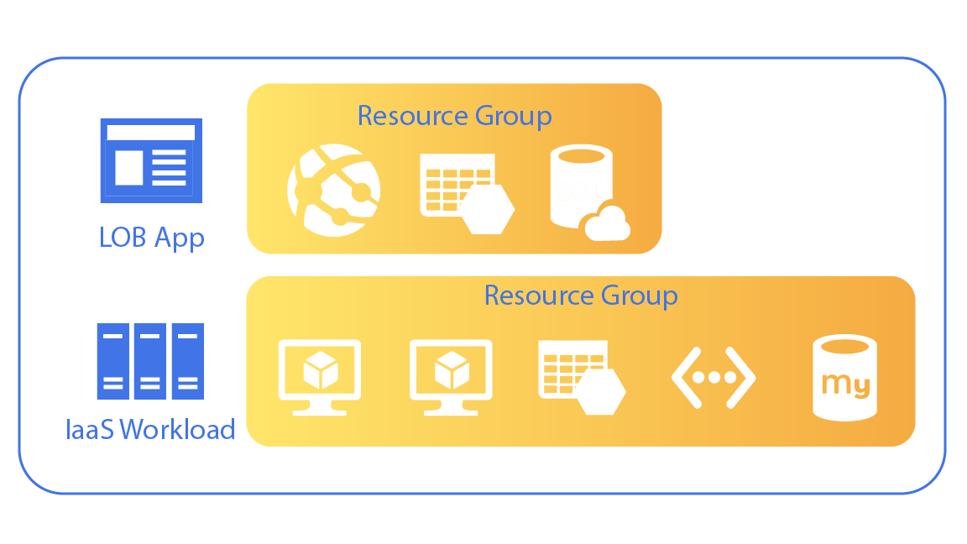
Azure Resource Groups
Resource group in Azure is simply a collection of related Azure assets or Azure services that belong to an application or workload together.
01
For example, the following diagram shows that the user has created a resource group for LOB application, for all the Azure services that belong to this application.
02
.
Then there is IaaS workload resource group that contains pair of virtual machines contained in a virtual network with a MySQL database for data.
.

Slide 71

Azure Subscriptions and Resources
To utilize Azure Cloud platform or to use Azure services, the very first thing that is required is Azure Subscription.
Relationship between Azure Subscription and Resources
Every resource will be deployed within a resource group
Every resource group has to be associated with an Azure subscription
User can create multiple resource groups with in one Azure subscription

Slide 72
Understanding Azure Resource Manager

Slide 73
Understanding Azure Resource Manager
Azure Resource Manager (ARM)
Azure resource manager (ARM) is the deployment and the management service for Azure resources.
01
Using this service, users can create, update, and delete resources in their Azure subscription.
02
03
It offers features like access control, auditing and tagging to secure and organize resources after deployment.

Slide 74
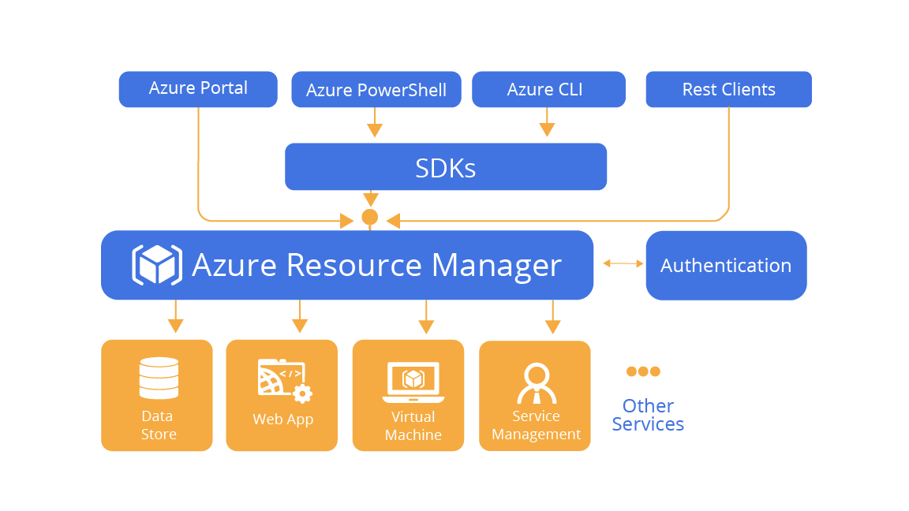
Understanding Azure Resource Manager
When any tool is used to take actions on Azure resources, the Azure Resource Manager API handles that request. The API passes requests to the Resource Manager service, which authenticates and authorizes the requests. Resource Manager then routes the requests to the appropriate service.

Slide 75
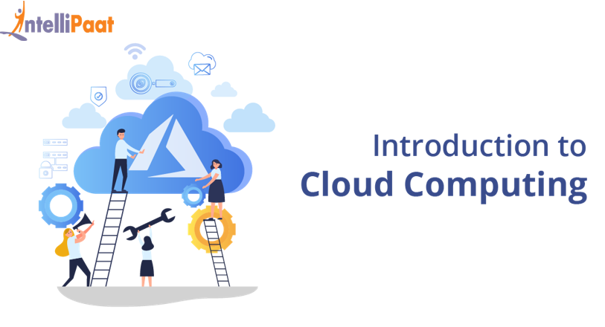
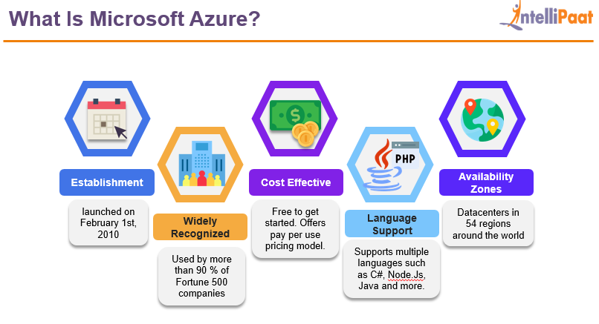
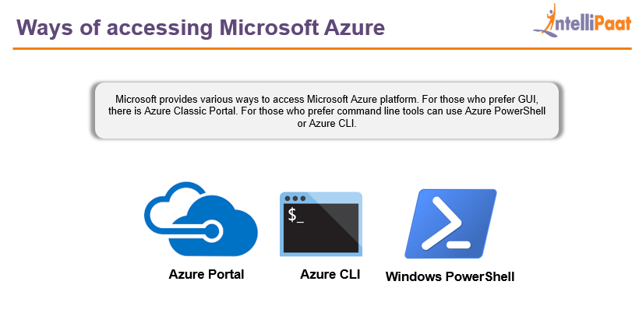
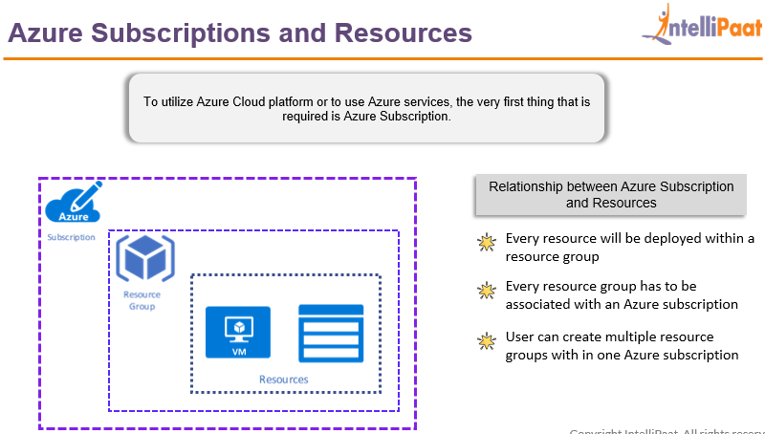
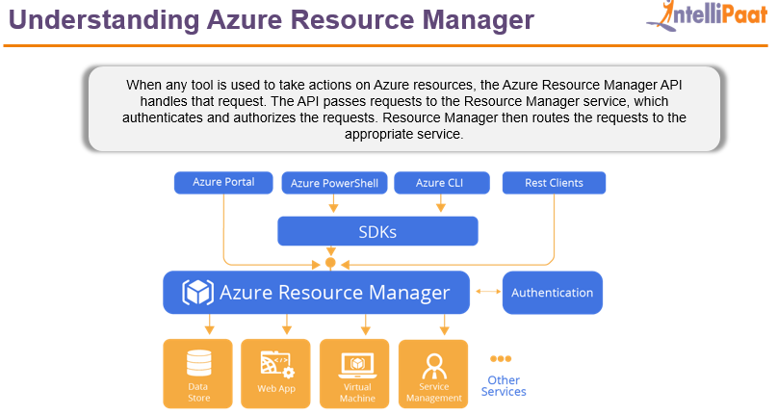
Session in a nutshell
Introduction to Cloud Computing
Introduction to Microsoft Azure
Ways of accessing Azure Platform
01
02
03
04
05
Azure Resources & Subscriptions
ARM & Azure Architecture

Slide 76
Demo - Managing Resource Groups

Slide 77
Demo
1. Create an Azure resource group
a) Deploy Azure resource in the resource group that you just created
2. Manage the Azure resources.
a) Move Azure resource from one resource group to another

Slide 78

Quiz
1. Cloud Computing came as a solution to which of the following problems?
A. Costly Server Management
B. Slow Data Recovery
C. High Upfront Expenses and Maintenance Cost
D. All of the above

Slide 79
Quiz
2. Which of the following Service domain is not offered by Azure?
A. Compute
B. Storage
C. IOT
D. All Service Domains are offered by Azure

Slide 80
Quiz
3. What is Microsoft Azure Portal?
A. Command line tool
B. Azure Storage Service
C. Azure Networking Service
D. Azure Web Based Console

Slide 81
Quiz
4. What is Microsoft Azure PowerShell?
A. Command line tool
B. Azure Storage Service
C. Azure Networking Service
D. Azure Web Based Console

Slide 82
Quiz
5. User can only have one Azure Subscription associated with one Azure Account. True or False ?
A. True
B. False

Slide 83
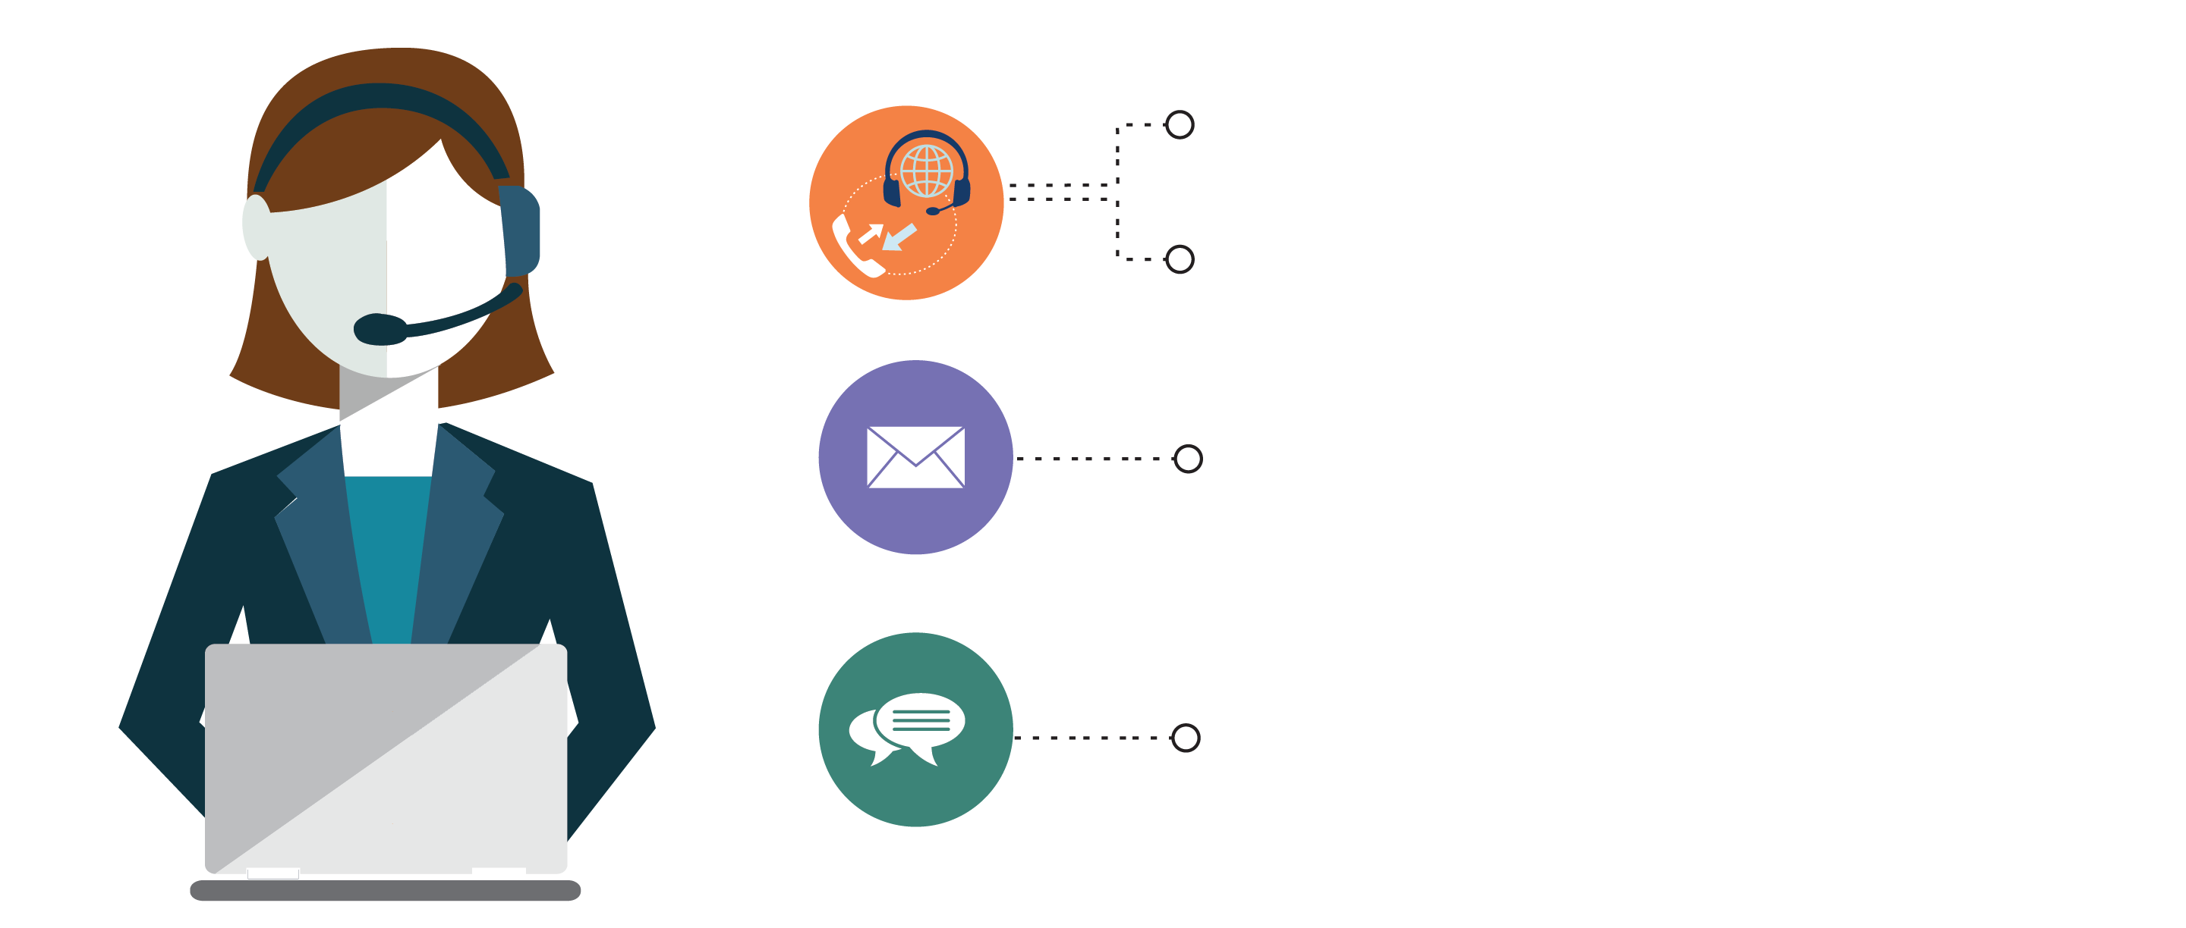
India: +91-7847955955
US: 1-800-216-8930 (TOLL FREE)
support@intellipaat.com
24/7 Chat with Our Course Advisor

